Slide 1
1.6.8.3 Subtraction of complex numbers

Slide 2
Introduction
In this topic, we will
Define the subtraction of complex numbers
Look at a geometric interpretation
Make some observations
Use this to define a distance between complex numbers

Slide 3
Complex subtraction
We define z – w as z + (–w) or z + (–1)w
If z = α + β j and w = γ + δ j, we have
z – w = (α + β j) – (γ + δ j)
= (α + β j) + (–γ – δ j)
= (α – γ) + (β – δ ) j

Slide 4
Complex subtraction
For example, if z = 0.7 – 8.4j and w = 1.5 + 6.3j,
it follows that
If z = –9.6 + 0.1j and w = –7.5 – 8.2j,
and again we see

Slide 5
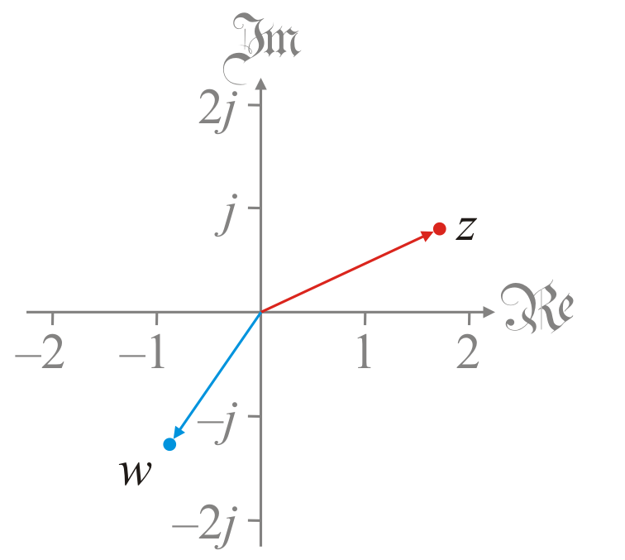
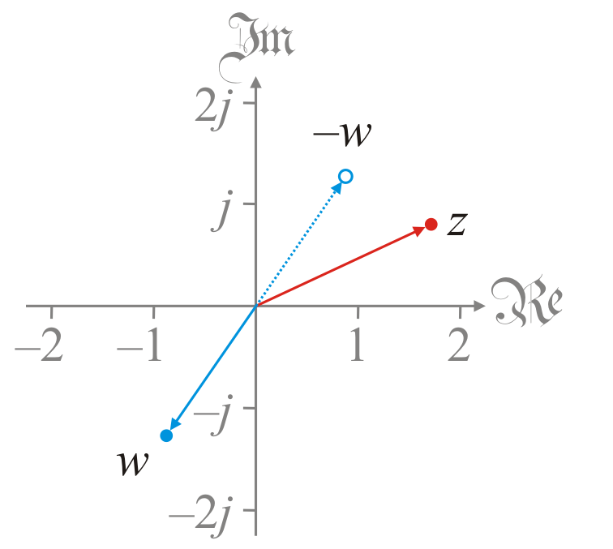
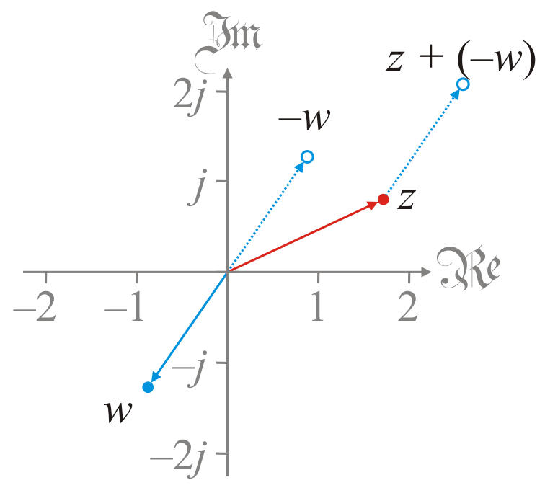
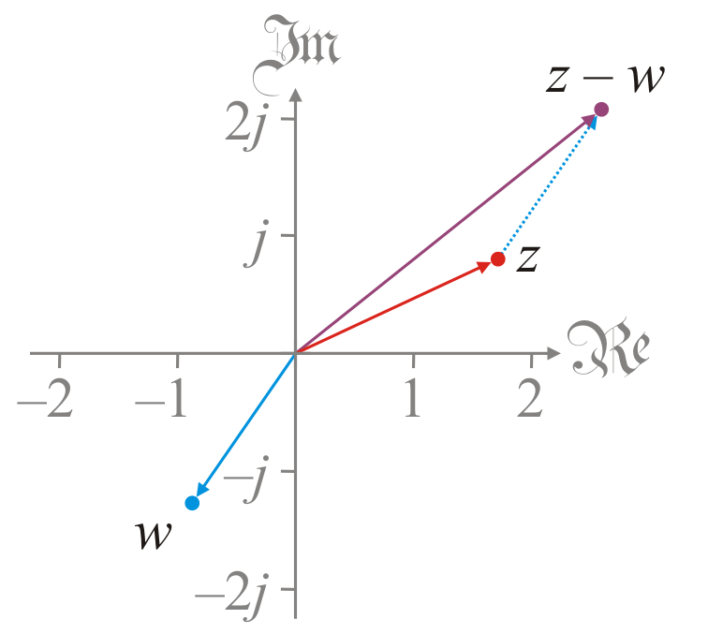
Complex subtraction
Going back to our geometric interpretation:
Here are z and w
The value –w is the reflection of w through 0
Add –w to z
This equals z – w

Slide 6
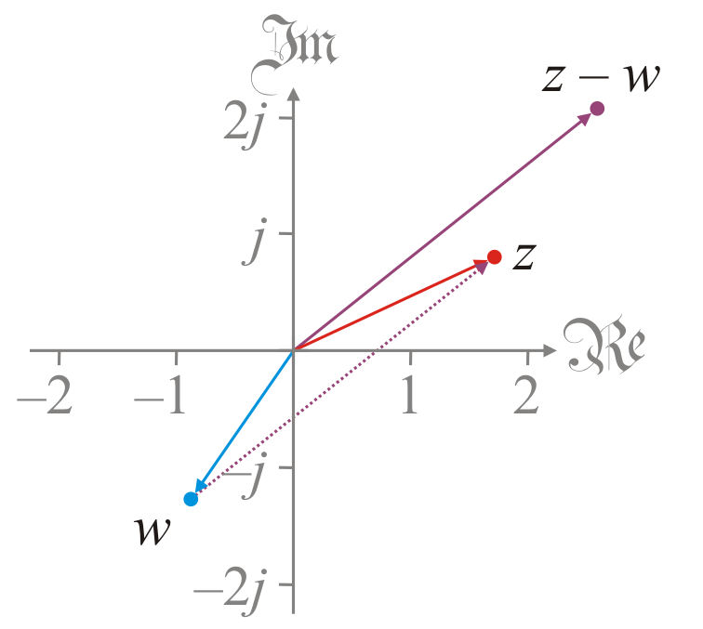
Complex subtraction
Visually,
The value z – w is a complex number going from w to z

Slide 7
Observation
Theorem: z – w = – (w – z)
That is, w – z is the additive inverse of z – w
Proof:
Theorem: Complex subtraction is not commutative
Proof: If z = 1 and w = j,
z – w = 1 – j ≠ –1 + j = w – z
QED
QED

Slide 8
Observation
By the way, you already use this when subtracting real numbers
Calculate x – y when x > y:
How do you calculate x – y when y > x?
Calculate y – x and negate the result, or x – y = – (y – x)

Slide 9
Observation
Theorem: z – w = 0 if and only if z = w
That is, z – w is not 0 if z and w are different complex numbers
Proof: Given z – w = 0, add w to both sides:
(z + (–w)) + w = w
z + ((–w) + w) = w
z + 0 = w
z = w
QED

Slide 10
Distance between complex numbers
We can also interpret |z – w| to be the distance between two complex numbers
Properties for you to prove:
|z – w| ≥ 0 The distance is non-negative
|z – w| = |w – z| The distance from z to w equals the distance from w to z
|z – w| = 0 if and only if z = w
|γ z – γ w| = |γ ||z – w| Multiplying both z and w by a real number γ scales the distance by |γ |

Slide 11
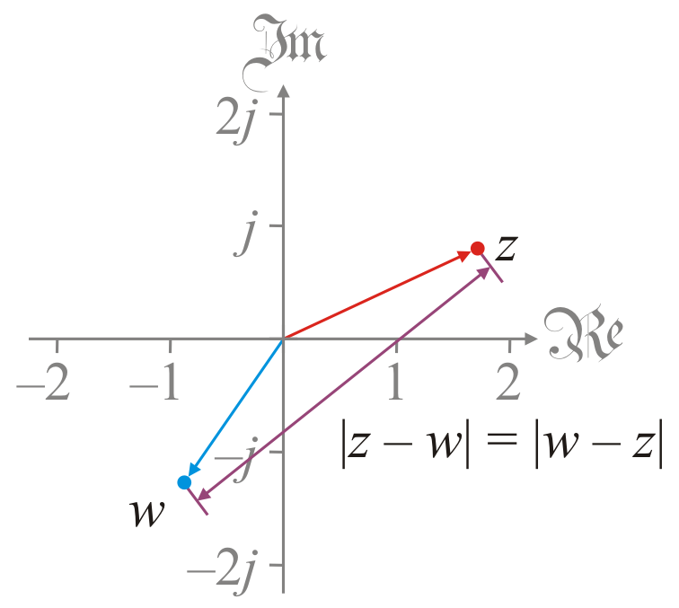
Distance between complex numbers
In our geometric interpretation of complex numbers,
we see that |z – w| is reasonably interpreted as the distance

Slide 12
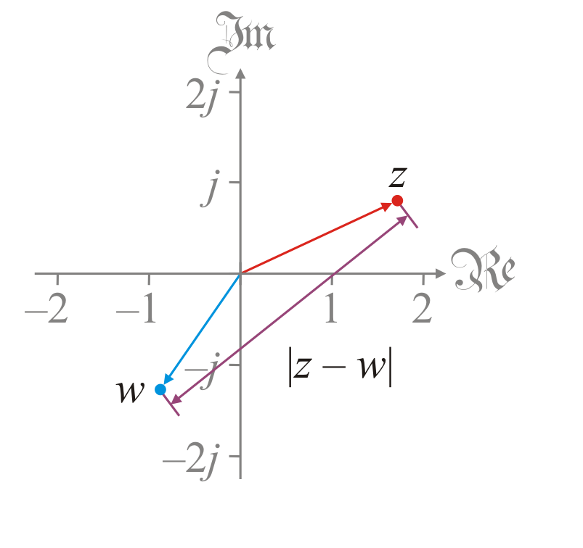
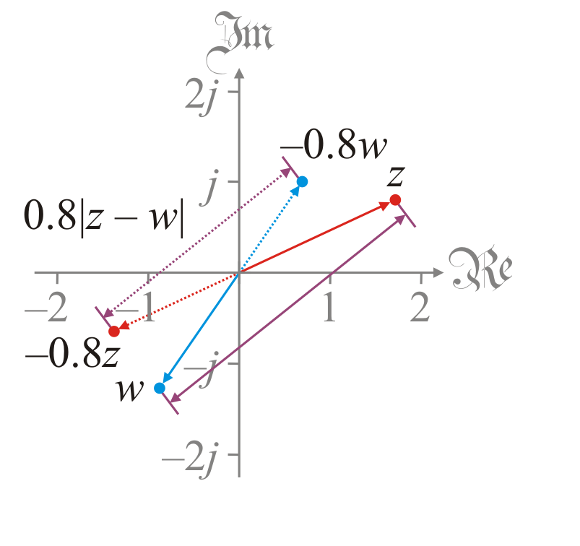
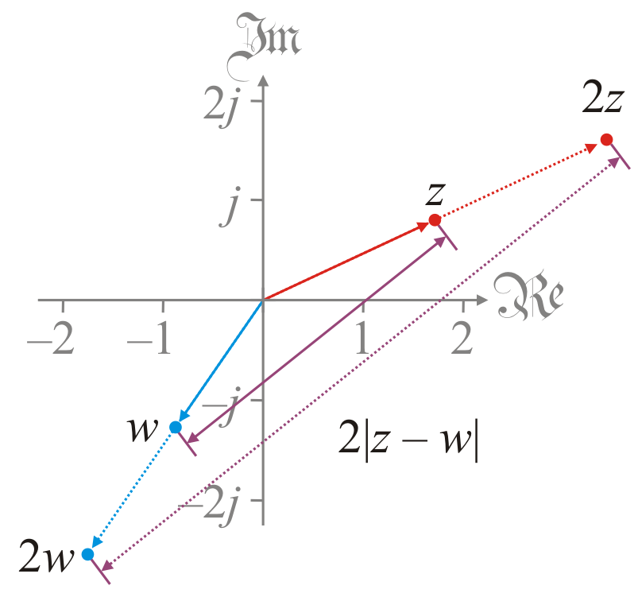
Distance between complex numbers
Let’s also look the property |γ z – γ w| = |γ ||z – w| visually:
Here are z and w with the distance |z – w|
Here are 2z and 2w with the distance 2|z – w|
Here are −0.8z and −0.8w with the distance 0.8|z – w|

Slide 13
Summary
In this topic, we’ve introduced the subtraction of complex numbers
We defined z – w so that z + (–w) = z + (–1)w
Observed that subtraction is not commutative
We looked at a few other properties
Interpreted |z – w| as the distance between z and w

Slide 14
References
[1] https://en.wikipedia.org/wiki/Complex_number#Addition_and_subtraction
[2] https://en.wikipedia.org/wiki/Absolute_value#Complex_numbers

Slide 15
Acknowledgments
None so far.

Slide 16
Colophon
These slides were prepared using the Cambria typeface. Mathematical equations use Times New Roman, and source code is presented using Consolas.
The photographs of flowers and a monarch butter appearing on the title slide and accenting the top of each other slide were taken at the Royal Botanical Gardens in October of 2017 by Douglas Wilhelm Harder. Please see
https://www.rbg.ca/
for more information.

Slide 17
Disclaimer
These slides are provided for the ne 112 Linear algebra for nanotechnology engineering course taught at the University of Waterloo. The material in it reflects the authors’ best judgment in light of the information available to them at the time of preparation. Any reliance on these course slides by any party for any other purpose are the responsibility of such parties. The authors accept no responsibility for damages, if any, suffered by any party as a result of decisions made or actions based on these course slides for any other purpose than that for which it was intended.

